Slide 1
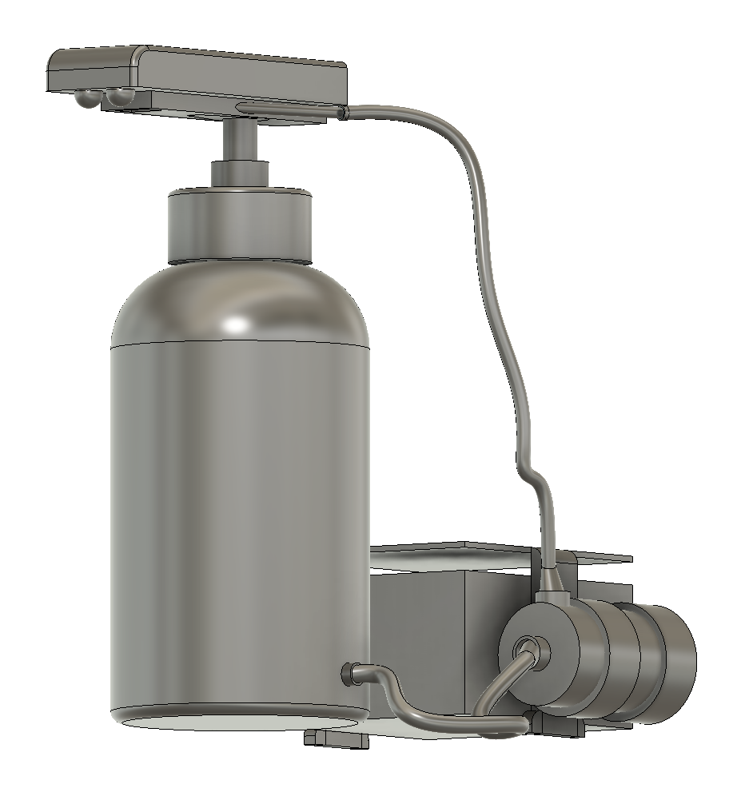
Automatic Hand-Sanitizer Dispenser
https://github.com/smlab-niser/rtc-sanitizer
Automatic Dispensing-Safe and easy use.
Records the amount of sanitizer dispensed in it’s memory.
Amount being dispensed per use can be adjusted easily
Can be attached to any off-the-shelf sanitizer container with minimal modification
Manual operation of the container retained-unchanged.
Infra-Red Proximity Sensor
Dispensing Outlet
Electronics and Control Unit
DC Electric Pump

Slide 2

About…
This machine is based on an Arduino NANO- which is the brain of it’s operation. We have coded it so that besides automating the dispensing process, it also records the pump’s “active” time- this helps in keeping a record for the amount of sanitizer dispensed.
The primary hardware used are: 12V DC Pump and an IR Proximity Sensor. There is a physical button to reset the Counter if required. And a Potentiometer to calibrate the amount to be dispensed per activation. It also has a Multi State LED indicator to make the operation intuitive.
While in Version 1 (current) of our project, reading the counter data is based on connecting the machine to a computer via USB- We are in process to develop a Version 2 which will have an on board 7 segment display to ease the process of taking readings.
“Simple yet effective” is the design philosophy behind our model. Physically it’s a very simple design- Our machine is basically “Attached” to a normal off the shelf sanitizer bottle and makes it automatic.
The whole unit operates at standard 5 volts (even the 12volt supply to the pump is based on a 5-12 DC-DC boost converter). Machine can be set in places which are “Off-Grid” with a simple USB power bank/Mobile charger. This is useful in situations like- say using such a machine in temporary establishments or on boundary gates of institutes, where generally grid power supply is not available.
This project is completely open source- 3d models, electrical designs, and Arduino sketches for this machine are available on our github page:

